Slide 1
LoRa
Mahdi Ali nejad, 401106266

Slide 2
01
What is LoRa
02
LoRa’s physical layer
03
LoRaWAN
link layer
04
LoRaBlink an idea

Slide 3
What is LoRa
Notes:
Source:
https://www.iotforall.com/lorawan-most-common-applications-and-use-cases
https://docs.arduino.cc/learn/communication/low-power-wide-area-networks-101/

Slide 4
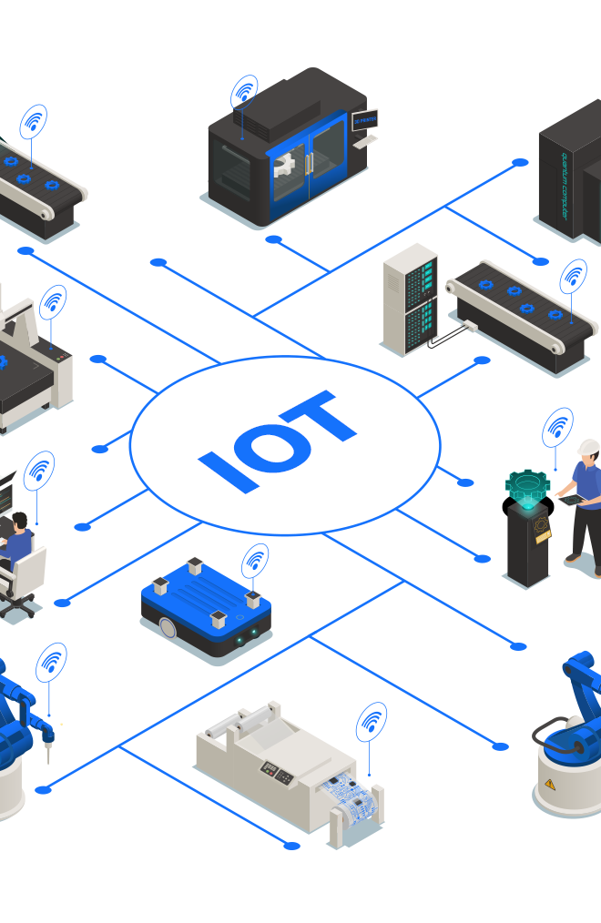
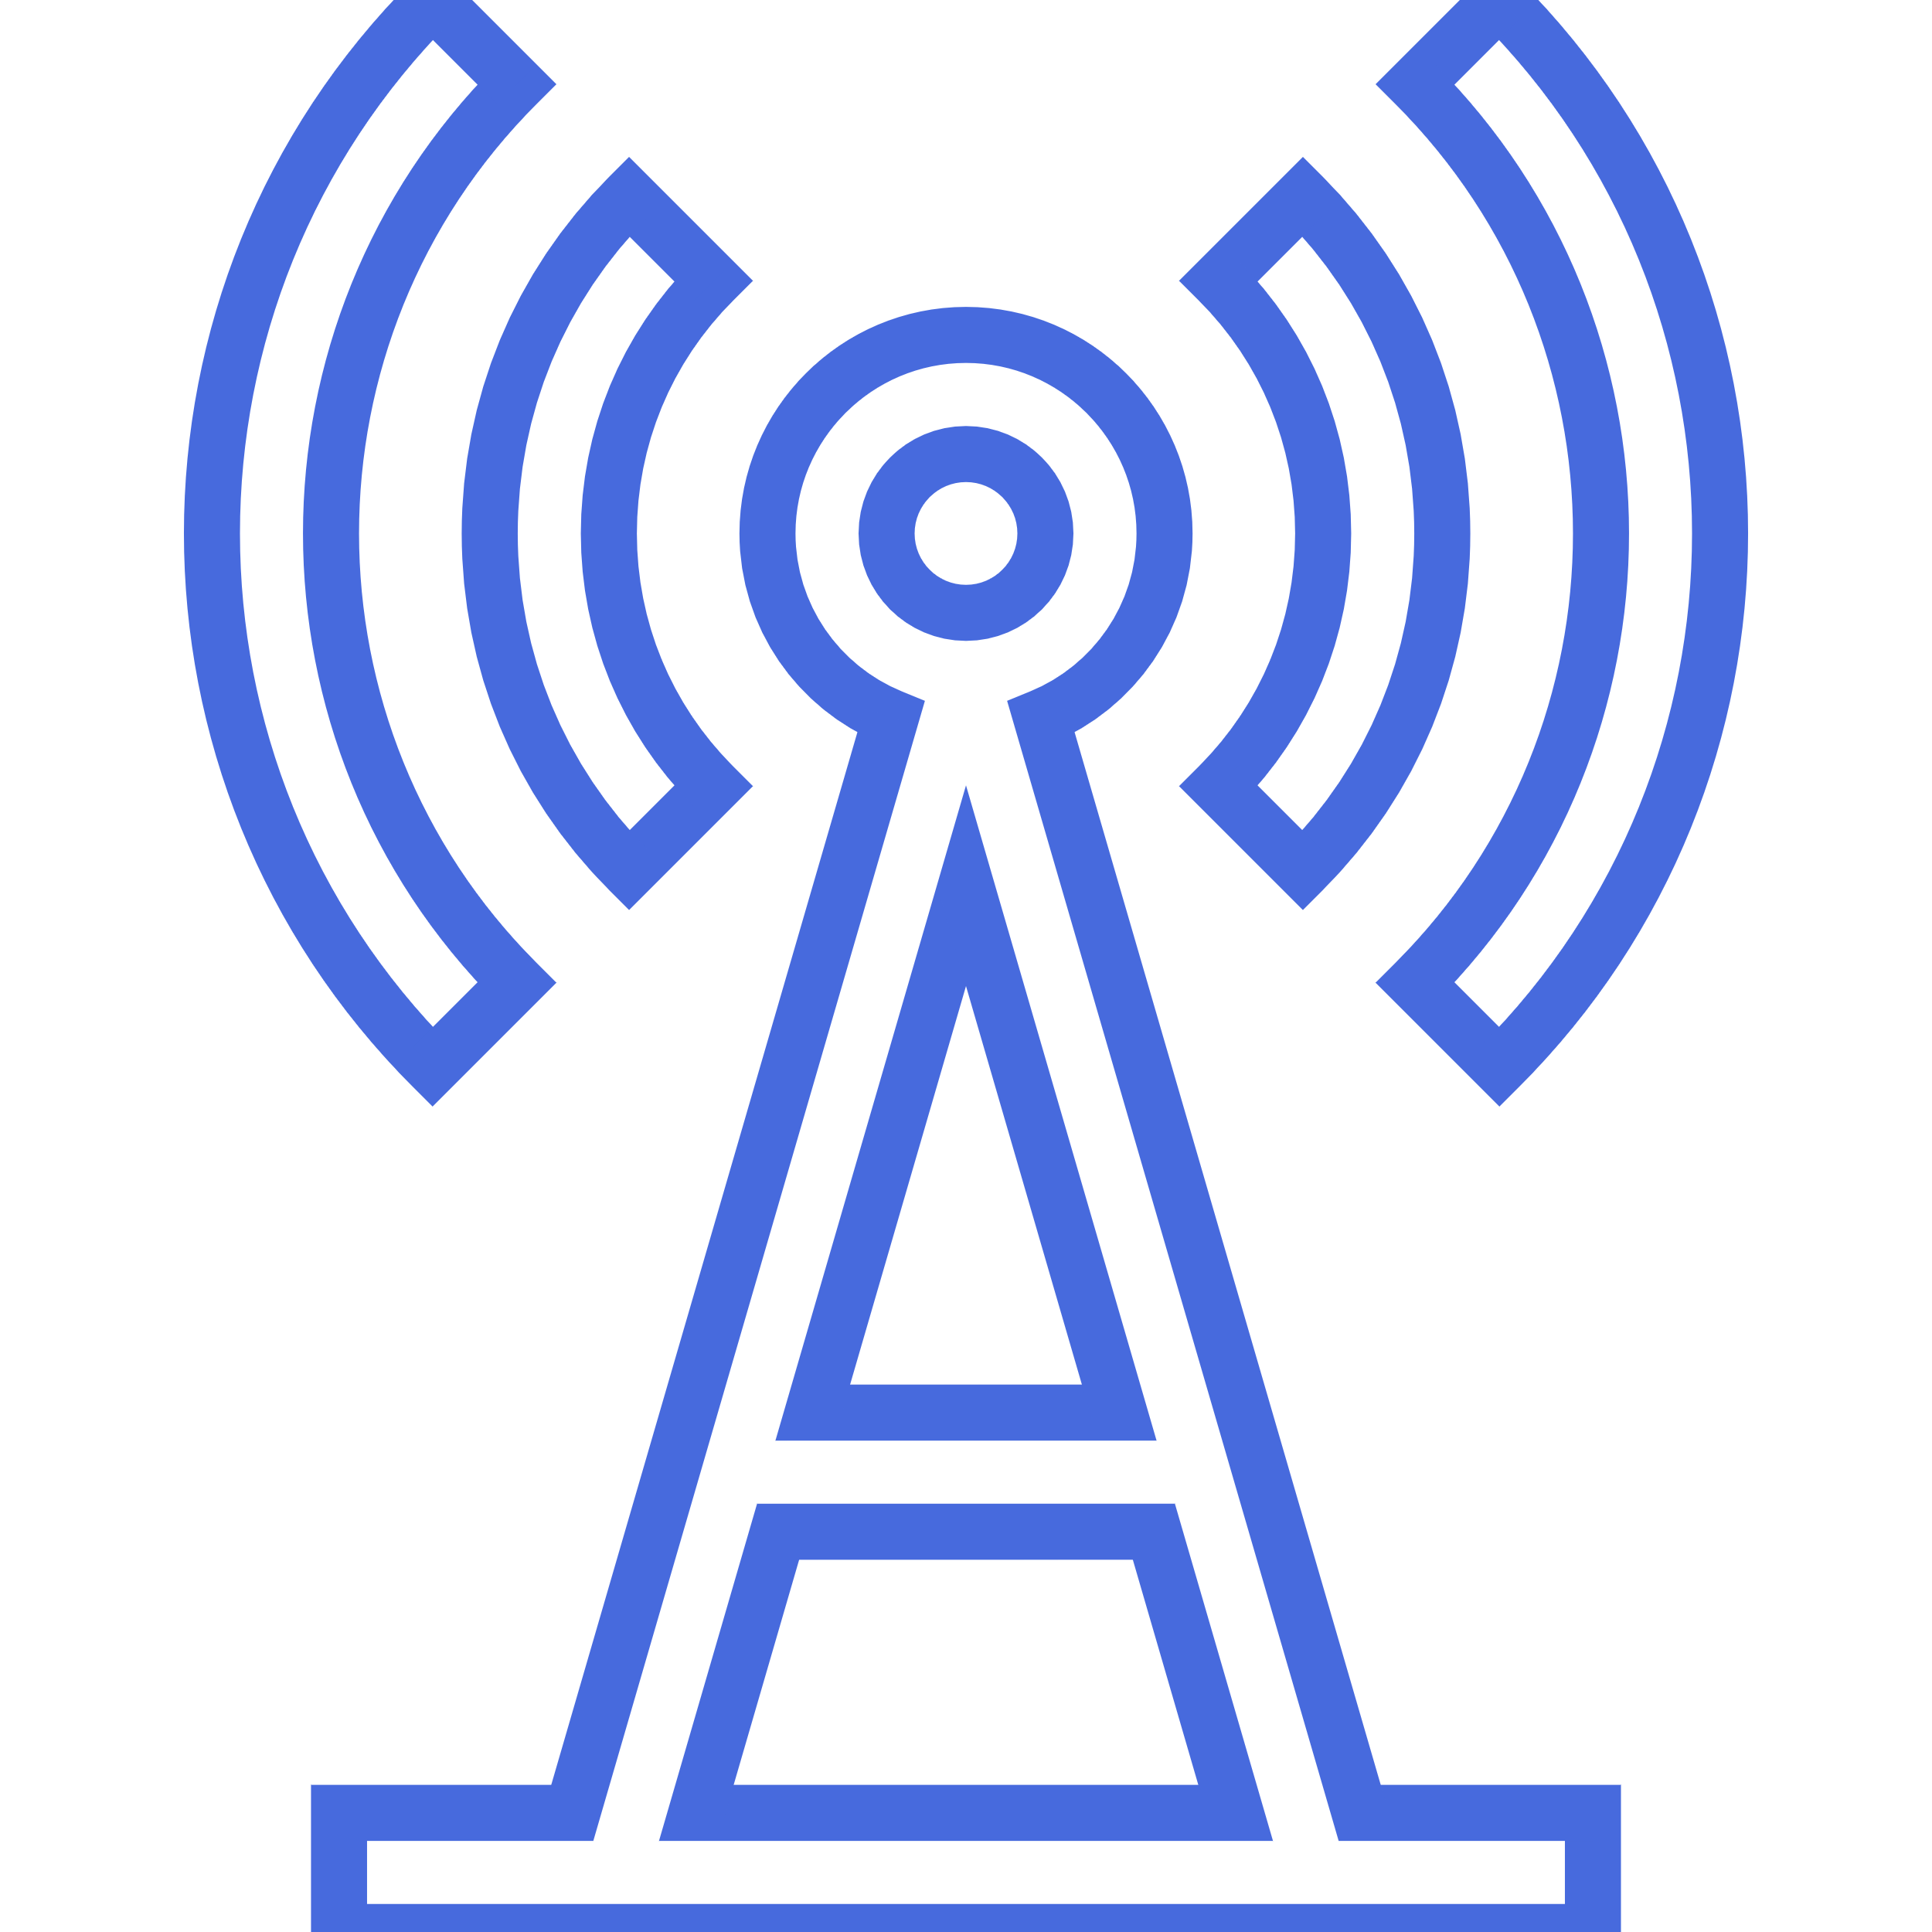

What is LoRa
Expected around 75 billion IoT devices
By 2025
Need for LPWAN
low-power wide-area network
Two types of technologies, Non-cellular-based technologies
Sigfox and LoRaWAN®
Cellular-based technologies
LTE-M and NB-IoT
4 of 23
70%
According to the report of Exploding Topics in 2024, around 70% of all devices around the globe are IoT devices, reaching a total of 30 billion, with an increase of 14% in 2022 and it will not stop any time soon.
Notes:
The exponential growth of the Internet of Things (IoT) and machine-to-machine (M2M) communications in the last few years has had an impact on almost every aspect of our daily lives. It is expected that by 2025 more than 75 billion IoT devices will be connected and working around the world.
The term LPWAN, which emerged in 2013, stands for low-power wide-area network. This is a generic term that describes a group of network technologies designed to communicate small data packets on low transmission data rates wirelessly, over relatively long distances using lower power than common network technologies (like WLANs or Bluetooth, for example). Transmission of small packets of data, low-power consumption, and wide-signal coverage are ideal characteristics for IoT and M2M devices and applications.
Non-cellular-based technologies: Sigfox and LoRaWAN®
Cellular-based technologies: LTE-M and NB-IoT
Internet of Things (IoT) has revolutionized the traditional Internet where only human-centric services were offered. It has enabled objects to have the ability to connect and communicate through the Internet. IoT has several applications such as smart water management systems. However, they require high energy-efficient sensor nodes that are able to communicate across long distance. This motivates the development of many Low-Power Wide Area Networks (LPWAN) technologies, such as LoRa, to fulfill these requirements.

Slide 5
What is LoRa
Smart Cities
Street lighting
Smart parking
Waste management
Water level and flood management
5 of 23
Notes:
What Are The Most Common Applications Of LoRaWAN?
A LoRaWAN network is compatible with a wide range of IoT applications and has been successfully used in the following Use Cases:
Smart Cities
Street Lighting
Smart Parking
Waste management
Water level and flood management
Smart Public Transit
Air Quality Control
Street Cleaning
Smart Buildings
Temperature and Humidity Monitoring
Room Occupancy
Motion Detection
Smart Water Metering
Fire, flood, CO/CO2 level Monitoring
Logistics and Transportation Management
successfully track high-value assets, including those in transit. Vehicles, goods, and other support are conveniently tracked over broad geographic regions and in severe circumstances because of the technology's remarkable range, low power consumption, and GPS-free localization.
Smart Healthcare
Hospital Patients
Seniors Care Residents
High Performing Athletes
Public Safety a panic button that sends an instant SOS with the user's location information.
Space Utilization
For firms, properly using and arranging available space has become a logistical headache.
Smart Environment
It is possible to record and publish environmental indicators for data analysis in real time by deploying a network of devices and gateways equipped with LoRaWAN networks over an area.
Smart Agriculture
IoT agriculture sensors have a compact size and determine many parameters that give an understanding of the environmental aspects. IoT sensors can be deployed to collect data about sunlight exposure, which can be used to make better decisions about crop placement and help determine if solar integration is a viable option for the farm.

Slide 6
What is LoRa
Smart Buildings
Temperature and Humidity Monitoring
Room Occupancy
Motion Detection
Smart Water Metering
Fire, flood, CO/CO2 level Monitoring
5 of 23
Notes:
What Are The Most Common Applications Of LoRaWAN?
A LoRaWAN network is compatible with a wide range of IoT applications and has been successfully used in the following Use Cases:
Smart Cities
Street Lighting
Smart Parking
Waste management
Water level and flood management
Smart Public Transit
Air Quality Control
Street Cleaning
Smart Buildings
Temperature and Humidity Monitoring
Room Occupancy
Motion Detection
Smart Water Metering
Fire, flood, CO/CO2 level Monitoring
Logistics and Transportation Management
successfully track high-value assets, including those in transit. Vehicles, goods, and other support are conveniently tracked over broad geographic regions and in severe circumstances because of the technology's remarkable range, low power consumption, and GPS-free localization.
Smart Healthcare
Hospital Patients
Seniors Care Residents
High Performing Athletes
Public Safety a panic button that sends an instant SOS with the user's location information.
Space Utilization
For firms, properly using and arranging available space has become a logistical headache.
Smart Environment
It is possible to record and publish environmental indicators for data analysis in real time by deploying a network of devices and gateways equipped with LoRaWAN networks over an area.
Smart Agriculture
IoT agriculture sensors have a compact size and determine many parameters that give an understanding of the environmental aspects. IoT sensors can be deployed to collect data about sunlight exposure, which can be used to make better decisions about crop placement and help determine if solar integration is a viable option for the farm.

Slide 7
What is LoRa
Logistics and Transportation Management
monitoring packages and vehicles
NFS payments
5 of 23
Notes:
What Are The Most Common Applications Of LoRaWAN?
A LoRaWAN network is compatible with a wide range of IoT applications and has been successfully used in the following Use Cases:
Smart Cities
Street Lighting
Smart Parking
Waste management
Water level and flood management
Smart Public Transit
Air Quality Control
Street Cleaning
Smart Buildings
Temperature and Humidity Monitoring
Room Occupancy
Motion Detection
Smart Water Metering
Fire, flood, CO/CO2 level Monitoring
Logistics and Transportation Management
successfully track high-value assets, including those in transit. Vehicles, goods, and other support are conveniently tracked over broad geographic regions and in severe circumstances because of the technology's remarkable range, low power consumption, and GPS-free localization.
Smart Healthcare
Hospital Patients
Seniors Care Residents
High Performing Athletes
Public Safety a panic button that sends an instant SOS with the user's location information.
Space Utilization
For firms, properly using and arranging available space has become a logistical headache.
Smart Environment
It is possible to record and publish environmental indicators for data analysis in real time by deploying a network of devices and gateways equipped with LoRaWAN networks over an area.
Smart Agriculture
IoT agriculture sensors have a compact size and determine many parameters that give an understanding of the environmental aspects. IoT sensors can be deployed to collect data about sunlight exposure, which can be used to make better decisions about crop placement and help determine if solar integration is a viable option for the farm.

Slide 8
What is LoRa
Smart Healthcare
Hospital Patients
Seniors Care Residents
High Performing Athletes
5 of 23
Notes:
What Are The Most Common Applications Of LoRaWAN?
A LoRaWAN network is compatible with a wide range of IoT applications and has been successfully used in the following Use Cases:
Smart Cities
Street Lighting
Smart Parking
Waste management
Water level and flood management
Smart Public Transit
Air Quality Control
Street Cleaning
Smart Buildings
Temperature and Humidity Monitoring
Room Occupancy
Motion Detection
Smart Water Metering
Fire, flood, CO/CO2 level Monitoring
Logistics and Transportation Management
successfully track high-value assets, including those in transit. Vehicles, goods, and other support are conveniently tracked over broad geographic regions and in severe circumstances because of the technology's remarkable range, low power consumption, and GPS-free localization.
Smart Healthcare
Hospital Patients
Seniors Care Residents
High Performing Athletes
Public Safety a panic button that sends an instant SOS with the user's location information.
Space Utilization
For firms, properly using and arranging available space has become a logistical headache.
Smart Environment
It is possible to record and publish environmental indicators for data analysis in real time by deploying a network of devices and gateways equipped with LoRaWAN networks over an area.
Smart Agriculture
IoT agriculture sensors have a compact size and determine many parameters that give an understanding of the environmental aspects. IoT sensors can be deployed to collect data about sunlight exposure, which can be used to make better decisions about crop placement and help determine if solar integration is a viable option for the farm.

Slide 9
What is LoRa
Others
Public Safety
Space Utilization
Smart Environment
Smart Agriculture
5 of 23
Notes:
What Are The Most Common Applications Of LoRaWAN?
A LoRaWAN network is compatible with a wide range of IoT applications and has been successfully used in the following Use Cases:
Smart Cities
Street Lighting
Smart Parking
Waste management
Water level and flood management
Smart Public Transit
Air Quality Control
Street Cleaning
Smart Buildings
Temperature and Humidity Monitoring
Room Occupancy
Motion Detection
Smart Water Metering
Fire, flood, CO/CO2 level Monitoring
Logistics and Transportation Management
successfully track high-value assets, including those in transit. Vehicles, goods, and other support are conveniently tracked over broad geographic regions and in severe circumstances because of the technology's remarkable range, low power consumption, and GPS-free localization.
Smart Healthcare
Hospital Patients
Seniors Care Residents
High Performing Athletes
Public Safety a panic button that sends an instant SOS with the user's location information.
Space Utilization
For firms, properly using and arranging available space has become a logistical headache.
Smart Environment
It is possible to record and publish environmental indicators for data analysis in real time by deploying a network of devices and gateways equipped with LoRaWAN networks over an area.
Smart Agriculture
IoT agriculture sensors have a compact size and determine many parameters that give an understanding of the environmental aspects. IoT sensors can be deployed to collect data about sunlight exposure, which can be used to make better decisions about crop placement and help determine if solar integration is a viable option for the farm.

Slide 10
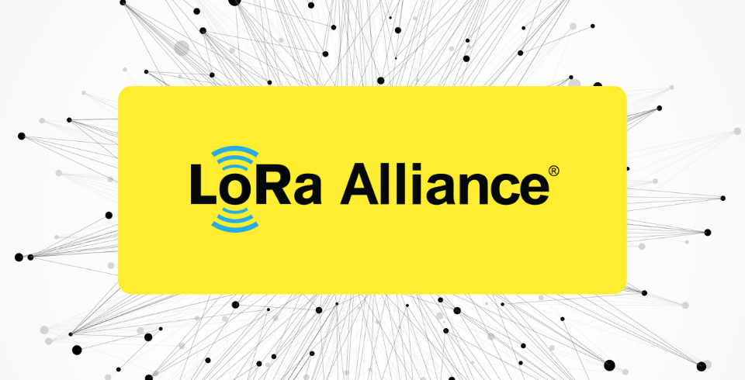
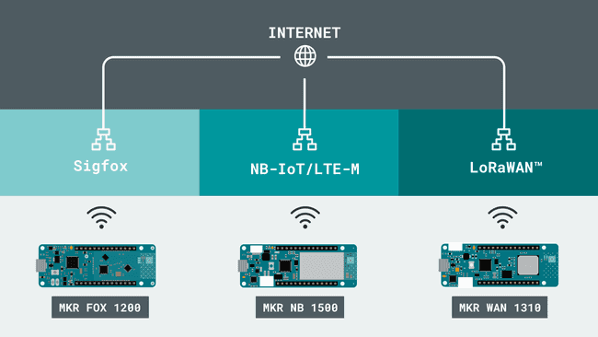
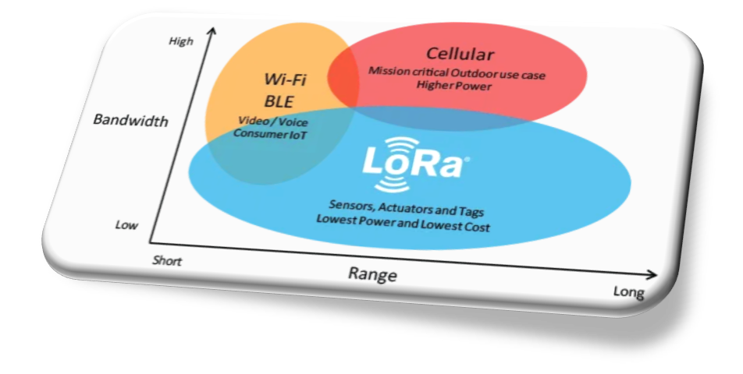

LoRa Alliance
LoRa Alliance
Open
Non-profit association
LoRa
Small packets
Long ranges
LPWAN Modules
MKR FOX 1200, BN 1500, WAN 1310
6 of 23
Notes:
LoRa Alliance Support for LoRaWAN
Our global, national, and regional networks will have to support billions or even trillions of Smart IoT devices all over the world in the future. LoRaWAN-based IoT solutions and the LoRaWAN technology will play a very important role in delivering an innovative, low-cost, and highly efficient network for future applications. There is a Lora Alliance association that unites more than 400 companies globally to contribute, improve and implement an intelligent LoRaWAN network for future needs.
The LoRa Alliance is an open, non-profit association of members that believes the Internet of Things era is now. The LoRa Alliance was initiated by industry leaders with a mission to standardize Low Power Wide Area Networks (LPWAN) being deployed around the world to enable the Internet of Things (IoT), machine-to-machine (M2M), and smart city, and industrial applications.

Slide 11
LoRa’s physical layer
Notes:
Source:
https://www.thethingsnetwork.org/docs/lorawan/lora-phy-format/
https://wirelesspi.com/understanding-lora-phy-long-range-physical-layer/

Slide 12
LoRa PHY
LoRa PHY
Chirp Spread Spectrum (CSS)
Frequency Shift Keying (FSK)
Benefits
Resiliance, robustness
Simple, low power consumption
Long-range, linear frequency modulation
8 of 23
Notes:
LoRa PHY, LoRa’s physical layer protocol. It is based on Chirp Spread Spectrum (CSS) modulation mixed with Frequency Shift Keying (FSK). This protocol allows for:
resistance to multipath fading and Doppler effect,
robustness against narrowband interference and jamming,
low RF power consumption owing to the constant envelope signal,
computationally simple from a signal processing perspective,
long-range transmission and reception, and
inherent ranging capability due to linear frequency modulation.

Slide 13
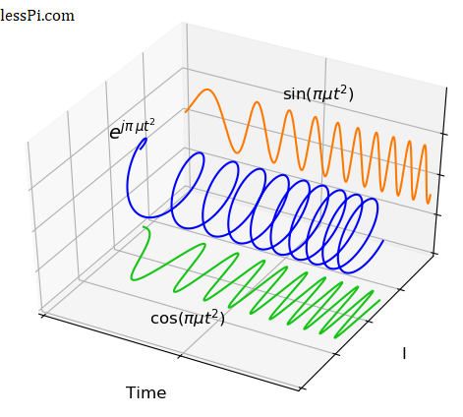
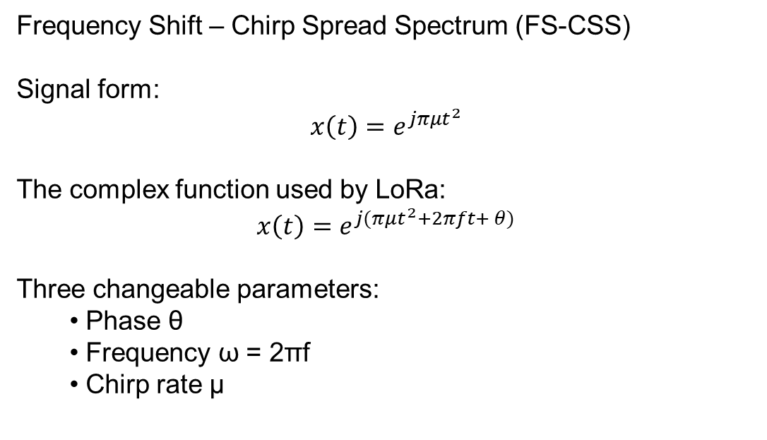
LoRa PHY
Frequency Shift – Chirp Spread Spectrum (FS-CSS)
Signal form:
$$x\left(t\right)=e^{jπμt^{2}}$$
The complex function used by LoRa:
$$x\left(t\right)=e^{j(πμt^{2}+2πft+ θ)}$$
Three changeable parameters:
Phase θ
Frequency ω = 2πf
Chirp rate μ
9 of 23
Notes:
From a basic complex sinusoid that includes a linear instantaneous phase, we can move towards a basic chirp by extending it into a quadratic instantaneous phase.
x(t)=e^(jπμt^2)
The factor π is actually 2π scaled by 1/2. This is included to normalize the chirp rate as the slope of the instantaneous frequency (which is defined as the derivative of the argument).
x(t)=e^j(πμt^2+2πft+θ)
Observe that there are three different parameters in the instantaneous phase that can be altered to transmit information.
Phase θ
Frequency ω=2πf
Chirp rate μ
The frequency can be used for modulation using this formula, for example for M = 4 we have:
F_1=B/M=B/4 and fm=mf1
A few specifications of the protocol are as follows.
Carrier Frequency The carrier frequency is determined by the center frequency around chirp variations. This can be from a few hundreds of MHz to about 1 GHz. Bandwidth Bandwidth is the part of spectrum spanned by the chirp. According to the specifications, one out of three possible options, namely 125 kHz, 250 kHz and 500 kHz, can be chosen. Symbol Rate We have seen above how transmission time for each of the MM possible signals is TMTM seconds. Inverse of this symbol time is the symbol rate given by
R_M=1/T_M
Chirp Rate As far as the chirp rate μ is concerned, it should be chosen from the figure on LoRa symbols such that each curve spans a time duration TMTM over a bandwidth B and returns to the same frequency where it starts.
Chip Rate In spread spectrum systems, the chip rate RcRc is defined as the symbol rate scaled by the spreading factor that ultimately determines the signal bandwidth BB.

Slide 14
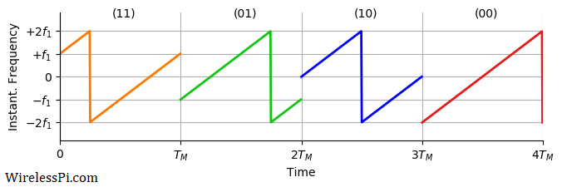
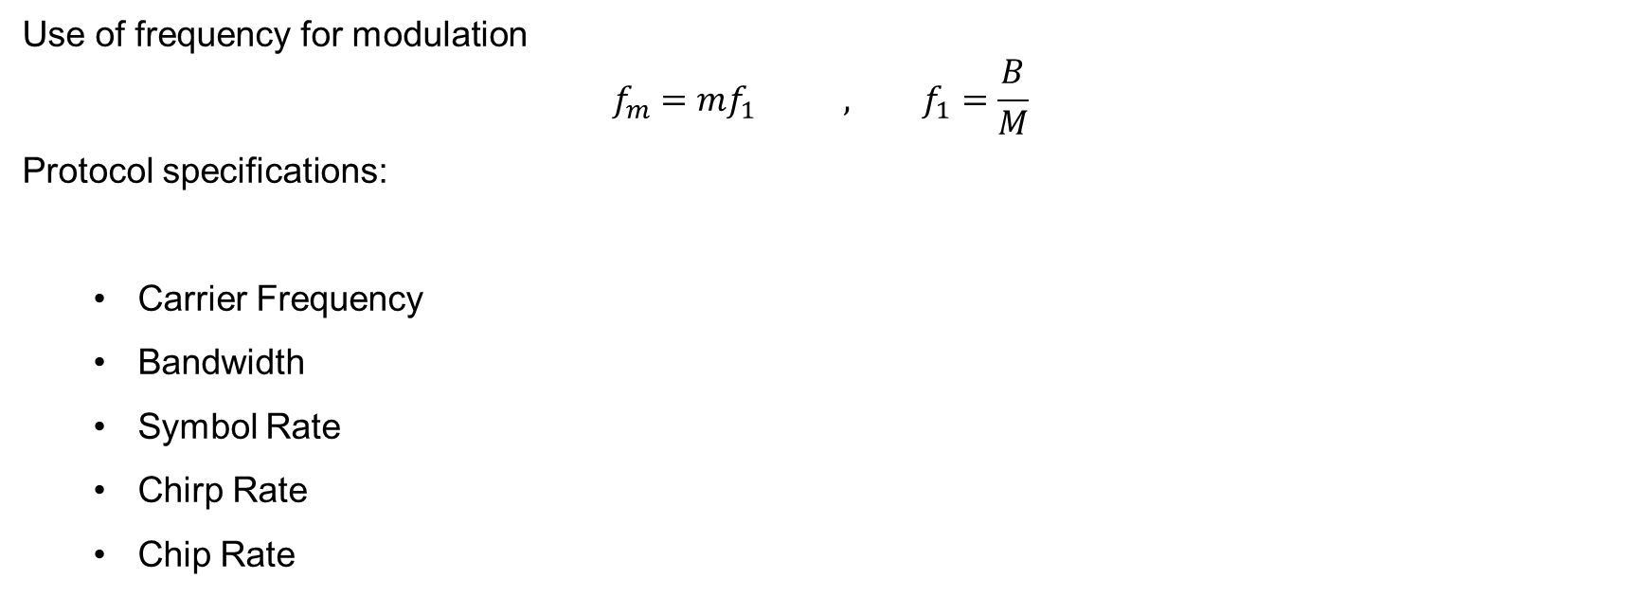
LoRa PHY
Use of frequency for modulation
$$f_{m}=mf_{1} , f_{1}=\frac{B}{M}$$
Protocol specifications:
Carrier Frequency
Bandwidth
Symbol Rate
Chirp Rate
Chip Rate
10 of 23
Notes:
From a basic complex sinusoid that includes a linear instantaneous phase, we can move towards a basic chirp by extending it into a quadratic instantaneous phase.
x(t)=e^(jπμt^2)
The factor π is actually 2π scaled by 1/2. This is included to normalize the chirp rate as the slope of the instantaneous frequency (which is defined as the derivative of the argument).
x(t)=e^j(πμt^2+2πft+θ)
Observe that there are three different parameters in the instantaneous phase that can be altered to transmit information.
Phase θ
Frequency ω=2πf
Chirp rate μ
The frequency can be used for modulation using this formula, for example for M = 4 we have:
F_1=B/M=B/4 and fm=mf1
A few specifications of the protocol are as follows.
Carrier Frequency The carrier frequency is determined by the center frequency around chirp variations. This can be from a few hundreds of MHz to about 1 GHz. Bandwidth Bandwidth is the part of spectrum spanned by the chirp. According to the specifications, one out of three possible options, namely 125 kHz, 250 kHz and 500 kHz, can be chosen. Symbol Rate We have seen above how transmission time for each of the M possible signals is TM seconds. Inverse of this symbol time is the symbol rate given by
R_M=1/T_M
Chirp Rate As far as the chirp rate μ is concerned, it should be chosen from the figure on LoRa symbols such that each curve spans a time duration TM over a bandwidth B and returns to the same frequency where it starts.
Chip Rate In spread spectrum systems, the chip rate Rc is defined as the symbol rate scaled by the spreading factor that ultimately determines the signal bandwidth B.

Slide 15
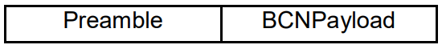
LoRa PHY
Two types of packets
explicit
implicit
11 of 23
Notes:
LoRa uses two types of packet formats for data transmission: explicit and implicit.
explicit
Preamble is used to synchronize the receiver with the transmitter. It MUST consist of 8 symbols for all regions as mentioned in the LoRaWAN Regional Parameters document. However, the radio transmitter will add another 4.25 symbols resulting in a final preamble length of 8 + 4.25 = 12.25 symbols.
PHDR (Physical Header) is an optional element only present in the explicit mode that contains information about payload size and CRC (Cyclic Redundancy Check).
PHDR_CRC (Header CRC) is an optional field that contains an error detecting code for correcting errors in header.
The PHDR and PHDR_CRC are encoded with the Coding Rate of 4/8.
PHYPayload contains the complete frame generated by the MAC layer. The maximum payload size varies by DR (Data Rate) and is region-specific.
CRC is an optional field that contains an error detecting code for correcting errors in the payload of uplink messages.
The PHYPayload and CRC are encoded with one of the Coding Rates (4/5, 4/6, 4/7, or 4/8). The complete frame is then sent using one of the Spreading Factors (SF = 7 to 12).
In implicit mode, the header is removed from the packet where the payload size and Coding Rate are fixed or known in advance.
Beacons use LoRa radio packet implicit mode for sending time synchronizing information from gateways to the end devices.

Slide 16
LoRaWAN
link layer

Slide 17
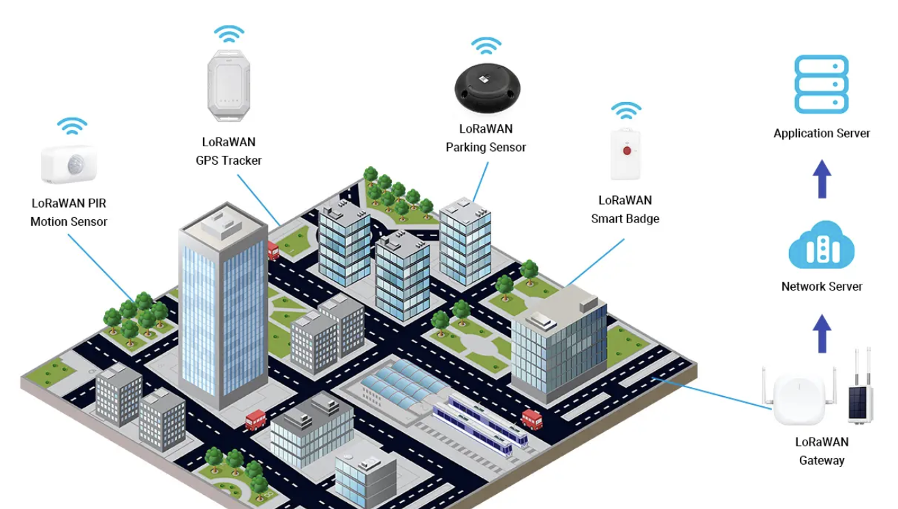
LoRaWAN
Range from 3km to 15km
LoRaWAN architecture:
Endpoint
Gateway
Network server
Application server
13 of 23
Notes:
LoRaWAN, governed by the LoRa Alliance, is characterized by its open standard network layer with support from a diverse industry alliance. Operating on the LoRa chip, it excels in uplink only applications through the efficient distribution of coded packets, reducing collision and interference. Despite being open standard, LoRaWAN’s dependence on Semtech’s chips for full stack implementation adds a layer of exclusivity.
Up to 3km in urban areas and 15km in rural areas
How LoRaWAN technology works
The LoRaWAN architecture includes end-devices/nodes with sensors, gateways, network server, and application server.
Endpoints connect over LoRa links with gateways deployed outdoors like on buildings, towers, etc. Gateways interface backhaul connectivity like WiFi, Ethernet or Cellular. They can cover miles long range with data rates that adapt between 0.3kbps to 50kbps.
Gateways forward messages from potentially millions of devices back to a central network server. It manages essential functions like security, addressing, device profiles, rules, data rate adaption etc. It also de-duplicates messages and controls confirmed delivery between applications and devices.
The network server hands off data through IP connections to an application server. This is where the IoT application and business logic resides, to decode sensor data and connect it with dashboards, analytics, cloud services etc.

Slide 18
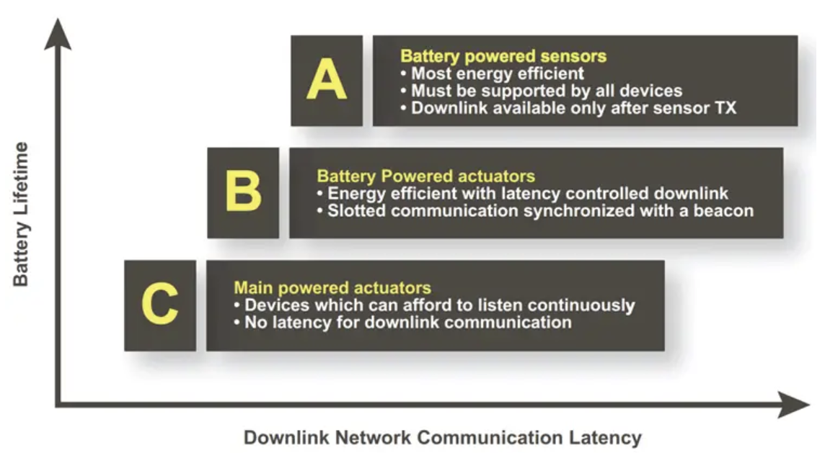
LoRaWAN
LoRaWAN device classes
Class A
Lowest power
Short downlink receives windows
Class B
Downlink windows in scheduled times
Class C
Minimum delay
Always receiving
14 of 23
Notes:
LoRaWAN device classes A, B, & C
LoRaWAN contains three different types of end devices to meet the different needs that arise in a wide range of applications:
Class A: Lowest power, and bidirectional end device
This is the default class that lets endpoints transmit uplink at any time, followed by two short downlink receive windows. As uplink communication is asynchronous and downlink follows uplink timing, devices can sleep maximizing battery life. Downlink messages get buffered on the server.
Class B: A bidirectional terminal device with deterministic downlink delay
Class B devices open additional receive windows at scheduled intervals synchronized with the network. This allows lower downlink latency at the cost of higher power consumption. The deterministic delay is programmable over 128 secs making it suitable for battery operation.
Class C: Minimum delay, bidirectional terminal equipment
Building on Class A, Class C keeps the receiver open continuously unless transmitting. This allows the server to downlink anytime with near zero delay. However, continuous listening can consume over 50mW, so Class C suits mains-powered applications. Temporary switching is possible.

Slide 19

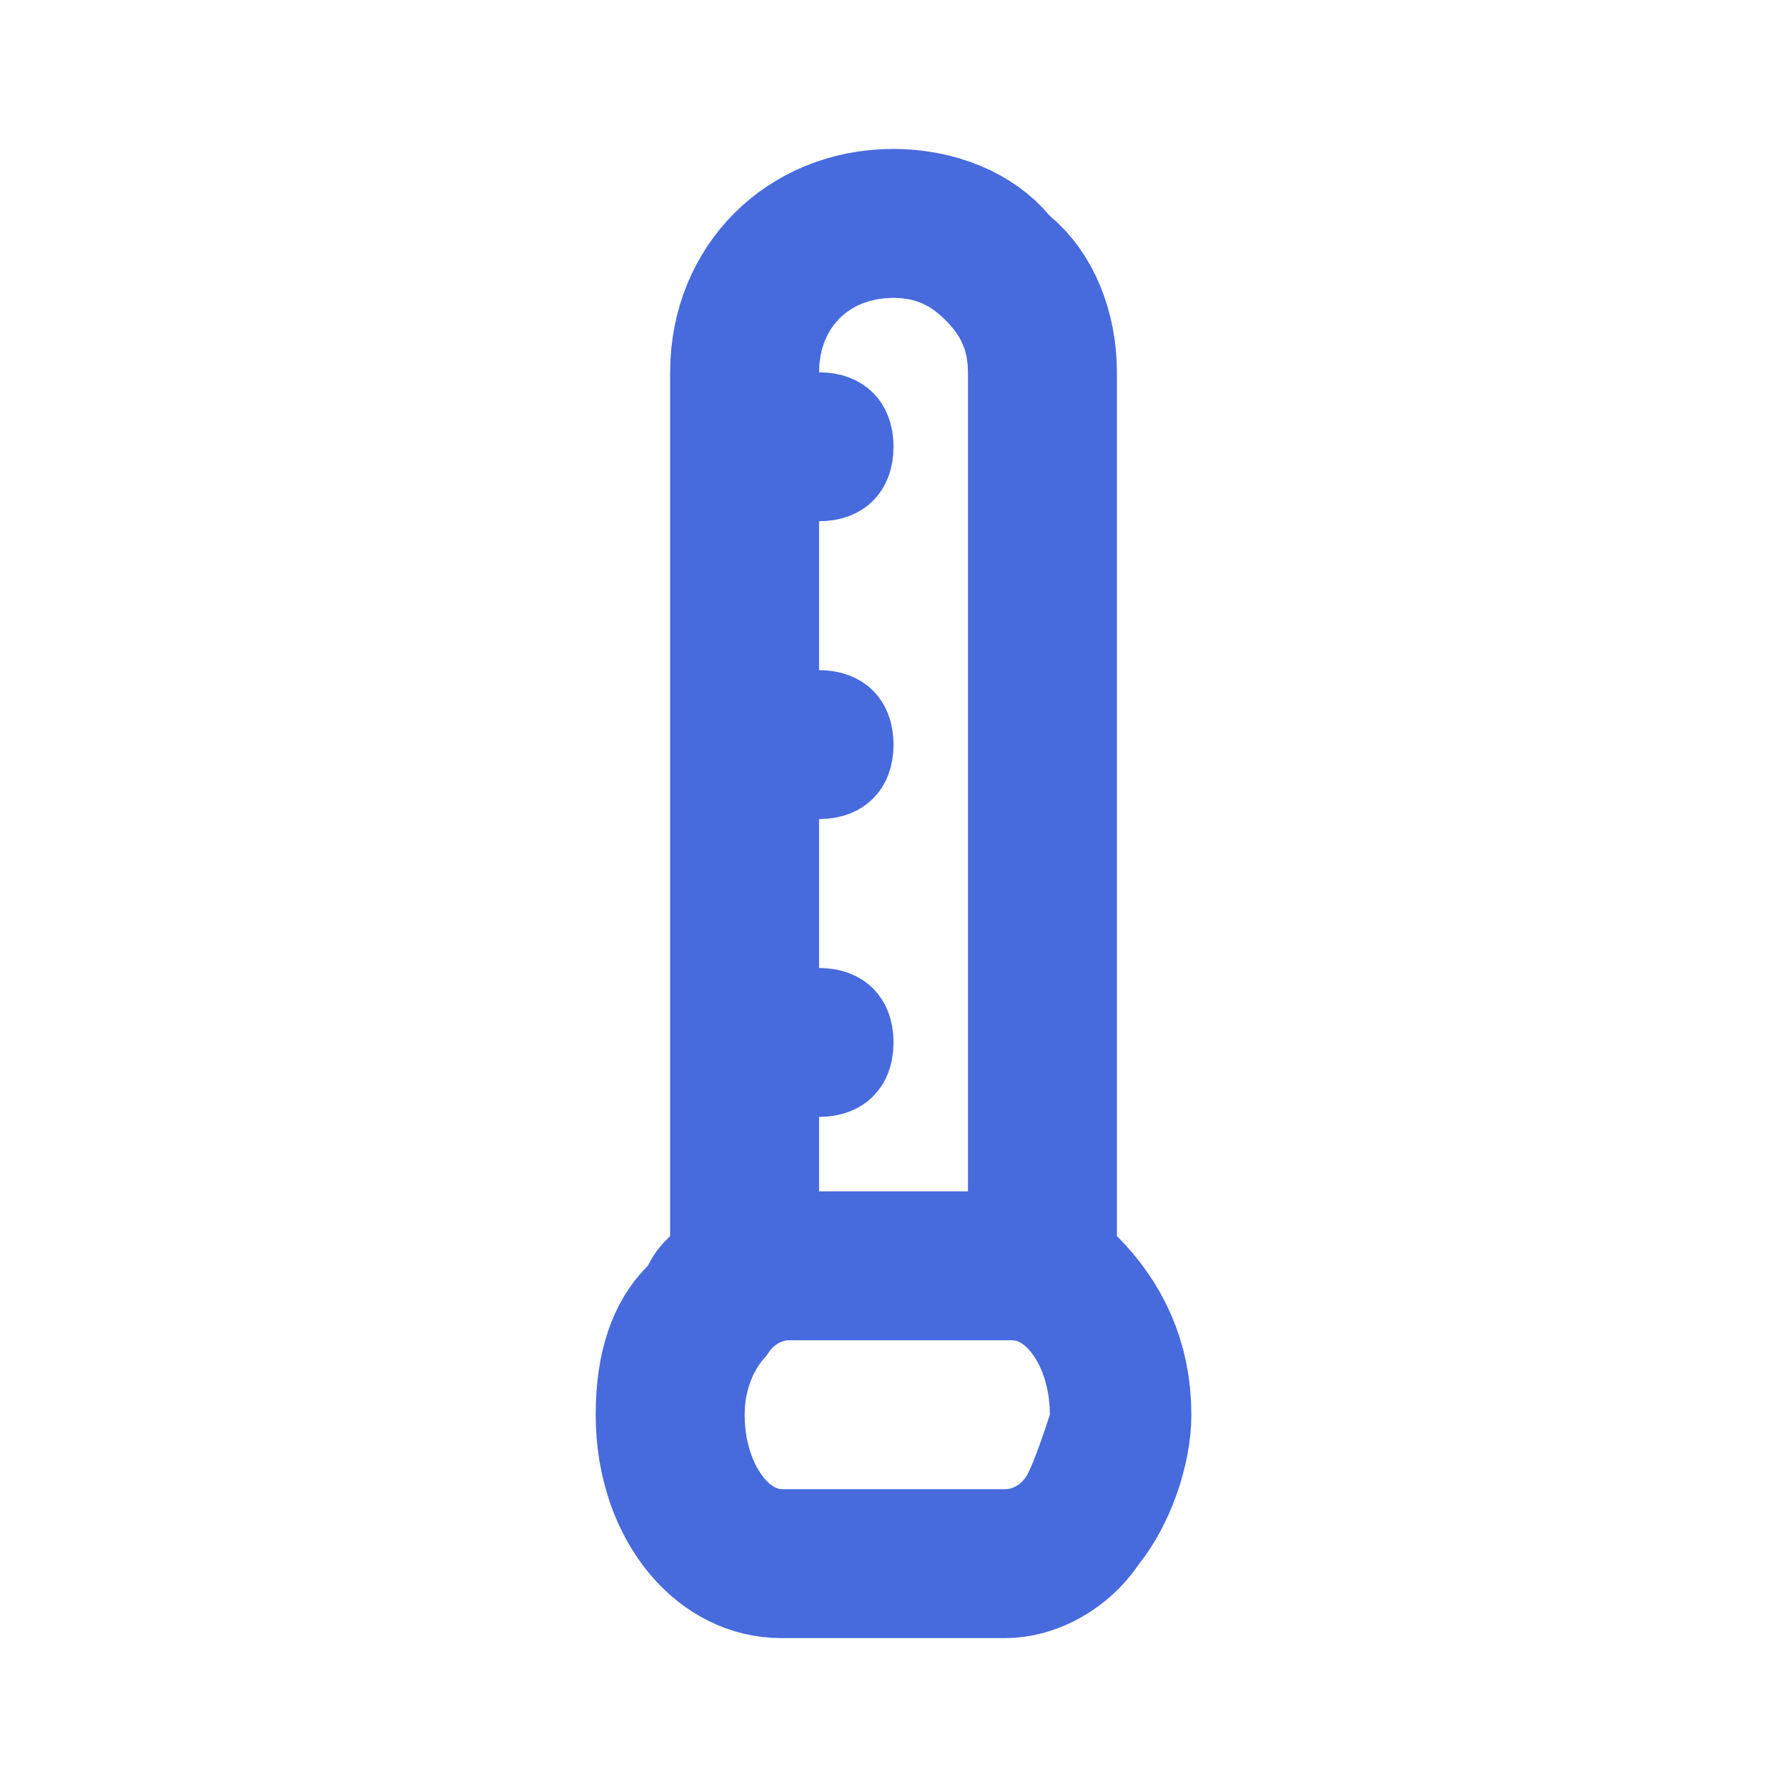
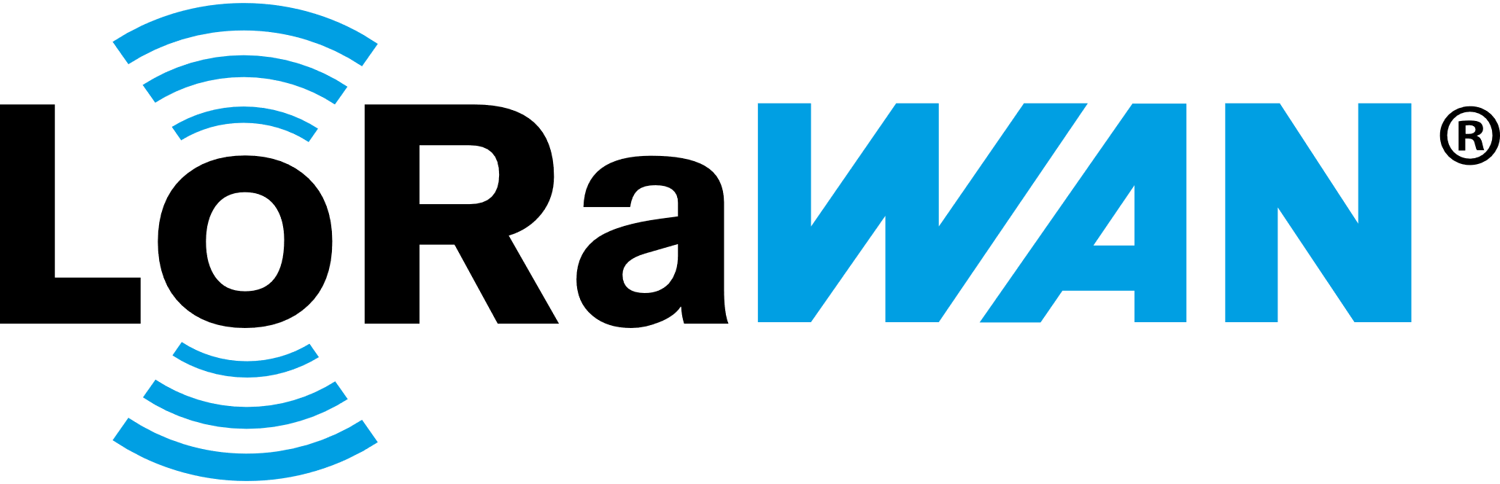


MOKOSmart LoRaWAN sensors
LoRaWAN PIR Motion Sensor
LoRaWAN Temperature Humidity Sensor
LoRaWAN GPS Tracker
LoRaWAN Panic Button
LoRaWAN Smart Badge
LoRaWAN Parking Sensor
15 of 23
Notes:
MOKOSmart LoRaWAN sensors for your application
MOKOSmart offers a variety of LoRaWAN-enabled sensors that are perfect for many long-range low-power IoT applications. Some of the MOKOSmart LoRaWAN sensors that may be useful include:
LoRaWAN PIR Motion Sensor: Detects motion and can be used for occupancy monitoring, intruder alerts, automation triggers, and more.
LoRaWAN GPS Tracker: Tracks the real-time location of assets and can also monitor temperature and movement. Useful for fleet management, asset tracking, and theft prevention.
LoRaWAN Temperature Humidity Sensor: Monitors ambient temperature and humidity levels. Great for cold chain logistics, HVAC monitoring, storage unit tracking, and environmental analytics.
LoRaWAN Panic Button: An emergency alert button that can notify personnel of issues or activate emergency response systems when pressed.
LoRaWAN Parking Sensor: Detects vehicle presence in a parking space. Enables smart parking applications and analytics.
LoRaWAN Smart Badge: Tracks real-time location of personnel and can also act as a panic button for sending alerts. Great for workforce management, access control, and safety applications.

Slide 20
LoRaBlink

Slide 21
LoRaBlink
Goals:
Multi-Hop
Low-Energy
Resilience
Low-Latency
Slotted channel access
Optional Ack
Possible relaying
17 of 23
Notes:
Protocol Aims LoRaBlink aims to address a number of aspects necessary for deployment of IoT applications and which are not covered by currently defined LoRa protocols. These are: • Multi-Hop: The protocol should support communication over multiple hops. • Low-Energy: Nodes should be able to duty-cycle to conserve energy and enable battery powered operations over long time spans. • Resilience: The protocol should be resilient and enable high message delivery probability. • Low-Latency: The protocol should enable low-latency communication.
Time synchronisation among nodes is used to define slotted channel access.
A node will aim to select its position based on minimal distance to the sink. In the example in Figure 4 the sink transmits a beacon received by node 1 and node 2. Both nodes use the beacon to determine epoch start and their distance to the sink (1 hop). In the next beacon slot node 1 and 2 transmit their beacon concurrently. Due to properties of the LoRa physical layer either one of these (depending on transmission time difference and perceived signal strength at node 3) is received at node 3. Node 3 updates its hop distance to the sink as 2 and transmits its own beacon in the next beacon slot. This beacon is received by node 2 (we assume node 1 would not receive) which discards the message as its hop count is less than 2. The number of beacon slots NB determines the maximum depth the network can have.
Following the beacon slots are ND data slots. A node that has data to transmit selects the next available data slot and transmits. After transmission a node listens for an Acknowledgement (ACK) (an optional protocol feature; the ACK is not shown in Figure 4). Two nodes may transmit in the same slot with the result that at least one message is decoded by one receiver, with a chance that two different nodes in the network decode one of each transmission. If a node has a lower hop count to the sink than the source node it will relay the message in the next slot. Multiple nodes may forward which introduces redundancy.

Slide 22
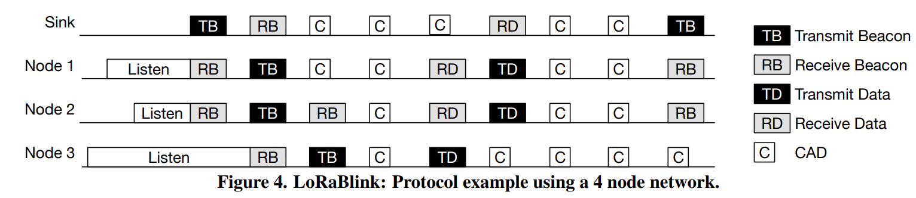
LoRaBlink
18 of 23
Notes:
Figure 4 shows an operation example of LoRaBlink in a network containing 3 nodes and a sink. Node 1 and 2 are in communication range of the sink. Node 3 cannot be directly reached by the sink but is in range of node 1 and 2. Each node powering up will remain in listen mode until a beacon is received. Beacons are used for time synchronisation and mark the start of an epoch. Each epoch contains N slots. The first NB slots of an epoch are used for beacon transmissions. A beacon message contains the hop distance to the sink and upon receiving a beacon a node will transmit its own beacon according to its distance to the sink.
To improve energy consumption of the system beacon messages are sent infrequent (a long epoch is used) and the CAD is used within slots to detect incoming transmissions. Infrequent beacon transmission is possible as tight time synchronisation in the network is not necessary.
Epoch length and NB and ND determine energy consumption and data transport delay in the network. While not the most energy efficient protocol, the additional range may be a benefit to low-node-density deployments, requiring far fewer forwarding nodes to cover the same area. The transceiver settings described in Section 3 and an epoch length of 15 min with NB = 3 and ND = 177 (5 second slot) we obtain a maximum node lifetime of 2 years with two AA batteries (5400 mA h) – assuming that one beacon is transmitted and two are received and all other slots in the epoch contain one CAD.

Slide 23
LoRaBlink
Feature/Aspect | LoRaWAN | LoRaBlink
Topology | Star topology where all nodes communicate directly with the gateway. | Multi-hop communication supporting data relaying via nodes.
Routing | Gateway-based centralized communication; no routing between nodes. | Decentralized; integrates MAC and routing for multi-hop communication.
Unique Features Used | Uses LoRa's physical layer features like long range and low power, but focused on single-hop communication. | Exploits LoRa features like concurrent transmissions and carrier activity detection for robust multi-hop communication.
Applications | Meter reading, environmental monitoring, and city-wide IoT solutions. | IoT deployments in challenging environments requiring multi-hop communication, such as rural or large campus networks.
19 of 23
Notes:
Figure 4 shows an operation example of LoRaBlink in a network containing 3 nodes and a sink. Node 1 and 2 are in communication range of the sink. Node 3 cannot be directly reached by the sink but is in range of node 1 and 2. Each node powering up will remain in listen mode until a beacon is received. Beacons are used for time synchronisation and mark the start of an epoch. Each epoch contains N slots. The first NB slots of an epoch are used for beacon transmissions. A beacon message contains the hop distance to the sink and upon receiving a beacon a node will transmit its own beacon according to its distance to the sink.
To improve energy consumption of the system beacon messages are sent infrequent (a long epoch is used) and the CAD is used within slots to detect incoming transmissions. Infrequent beacon transmission is possible as tight time synchronisation in the network is not necessary.
Epoch length and NB and ND determine energy consumption and data transport delay in the network. While not the most energy efficient protocol, the additional range may be a benefit to low-node-density deployments, requiring far fewer forwarding nodes to cover the same area. The transceiver settings described in Section 3 and an epoch length of 15 min with NB = 3 and ND = 177 (5 second slot) we obtain a maximum node lifetime of 2 years with two AA batteries (5400 mA h) – assuming that one beacon is transmitted and two are received and all other slots in the epoch contain one CAD.

Slide 24
Conclusion
Need of communication
Low Power Wide Area Networks
LoRa Alliance
LoRa PHY
Use of FSK and CSS
Physical layer packets

Slide 25
Conclusion
LoRaWAN
Different classes
LoRaWAN gadgets
LoRaBlink
Add multihop
Sinks and Beacons

Slide 26
recsourses
IoT for all
Arduino101
The things network
Wireless pi
LoRaBlink

Slide 27
THANK YOU

